Slide 1


Slide 2


Slide 4


Slide 5
Wednesday, 14 April 2021

Slide 6
Notes
Wednesday, 14 April 2021

Slide 7

No Media Selected
Wednesday, 14 April 2021

Slide 8



Shutdown
What are you going to do?
Shutdown
Restart
Cancel
nestorOS 21.04 Lite

Slide 9
nestorOS 21.04 Lite

Slide 10
Welcome
Loading User Files…
nestorOS 21.04 Lite

Slide 12




Activities
20:44
nestorOS

Slide 13
Activities
20:44
nestorOS

Slide 14
Activities
20:44
nestorOS

Slide 16
Signed Off
Shutting Down…
Terminating Services…
nestorOS 21.04 Lite

Slide 18
nsUI
It is now safe to turn off your computer

Slide 19
Activities
20:44
nestorOS

Slide 21
Signed Off
Restarting…
Terminating Services…
nestorOS 21.04 Lite

Slide 23
nsUI
To restart, click here

Slide 24
CyWeb v1
Tab 1 – CyWeb v1
+
Tab 1
Tab 2
Tab 3
Tab 4

Slide 25
nestorOS Explorer 14
+
Tab 1 – CyWeb v1
Tab 1
Tab 2
Tab 3
Tab 4

Slide 26
CyWeb v1
Tab 2 – CyWeb v1
+
Tab 1
Tab 2
Tab 3
Tab 4

Slide 27
nestorOS Explorer 14
+
Tab 2 – CyWeb v1
Tab 1
Tab 2
Tab 3
Tab 4

Slide 28
CyWeb v1
Tab 3 – CyWeb v1
+
Tab 1
Tab 2
Tab 3
Tab 4

Slide 29
nestorOS Explorer 14
+
Tab 3 – CyWeb v1
Tab 1
Tab 2
Tab 3
Tab 4

Slide 30
CyWeb v1
Tab 4 – CyWeb v1
+
Tab 1
Tab 2
Tab 3
Tab 4

Slide 31
nestorOS Explorer 14
+
Tab 4 – CyWeb v1
Tab 1
Tab 2
Tab 3
Tab 4

Slide 32




Open app…
Calculator
Musify 7X
Filmify 7X
Imagify 7X
File Explorer

Slide 33
Multitasking Tab – CyWeb v1
nestorOS Explorer 14
Calculator
1
2
3
+
-
4
5
6
*
7
8
9
/
0
C
=

Slide 34
Multitasking Tab – CyWeb v1
Windows Drives
nestorOS Explorer 14

Slide 35
Multitasking Tab – CyWeb v1
Musify 7X
nestorOS Explorer 14
No Media Selected

Slide 36
Multitasking Tab – CyWeb v1
Filmify 7X
nestorOS Explorer 14
+

Slide 37
Multitasking Tab – CyWeb v1
nestorOS Explorer 14
Imagify 7X
Import (19:9)
Import (16:10)
Import (16:9)
Import (19,5:9)
Import (1:1)
Import (4:3)
Import (21:9)
Import (18:9)
Import (20:9)

Slide 38


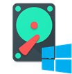


File Explorer
This PC
This PC
This PC
Hard Drives (2)
Documents
Images
Windows Drives
1.3TB free of 2.5TB
Desktop
Music
nestorOS Disk
499GB free of 500GB
Videos
Folders (5)
Windows Drives
nestorOS Disk
Documents
Images
Desktop
Music
Videos

Slide 39
This PC
This PC
Documents
Hard Drives (2)
Images
Windows Drives
1.3TB free of 2.5TB
Desktop
Music
nestorOS Disk
499GB free of 500GB
Videos
Windows Drives
Folders (5)
nestorOS Disk
Documents
Images
Desktop
Music
Videos

Slide 40
File Explorer
C:\ WINDOWS
+
C:\ WINDOWS
Documents
Images
Desktop
Music
Videos
Windows Drives
nestorOS Disk

Slide 41
C:\ WINDOWS
+
C:\ WINDOWS
Documents
Images
Desktop
Music
Videos
Windows Drives
nestorOS Disk

Slide 42
Open app…
Calculator
Musify 7X
Filmify 7X
Imagify 7X
CyWeb v1

Slide 43
Windows Drives
Calculator
1
2
3
+
-
4
5
6
*
7
8
9
/
0
C
=

Slide 44
Windows Drives
Musify 7X
nestorOS Explorer 14
No Media Selected

Slide 45
Windows Drives
Filmify 7X
+

Slide 46
Windows Drives
Imagify 7X
Import (19:9)
Import (16:10)
Import (16:9)
Import (19,5:9)
Import (1:1)
Import (4:3)
Import (21:9)
Import (18:9)
Import (20:9)

Slide 47

File Explorer
nestorOS Disk
nestorOS Disk
Documents
nfs64
6/1/2021, 23:29
users
6/1/2021, 23:29
Images
nsui-progs
6/1/2021, 23:29
Desktop
Music
Videos
Windows Drives
nestorOS Disk

Slide 48
nestorOS Disk
nestorOS Disk
Documents
nfs64
6/1/2021, 23:29
users
6/1/2021, 23:29
Images
nsui-progs
6/1/2021, 23:29
Desktop
Music
Videos
Windows Drives
nestorOS Disk

Slide 49
File Explorer
nfs64
nestorOS Disk / nfs64
nsUI Disk / nfs64
Files are hidden
Documents
Images
The files are part of the nsUI system.
No solutions are abviable for this problem.
Desktop
Music
Videos
Windows Drives
nestorOS Disk

Slide 50
nfs64 – File Explorer
nestorOS Disk / nfs64
Documents
Files are hidden
Images
The files are part of the nsUI system.
No solutions are abviable for this problem.
Desktop
Music
Videos
Windows Drives
nestorOS Disk

Slide 51
File Explorer
users
nestorOS Disk / users
nsUI
2/6/2020, 14:31
Documents
Images
Desktop
Music
Videos
Windows Drives
nestorOS Disk

Slide 52
users – File Explorer
nestorOS Disk / users
Documents
nsUI
2/6/2020, 14:31
Images
Desktop
Music
Videos
Windows Drives
nestorOS Disk

Slide 53
File Explorer
Documents
Documents
Documents
Images
Desktop
Music
Videos
Windows Drives
nestorOS Disk

Slide 54
Documents – File Explorer
Documents
Documents
Images
Desktop
Music
Videos
Windows Drives
nestorOS Disk

Slide 55
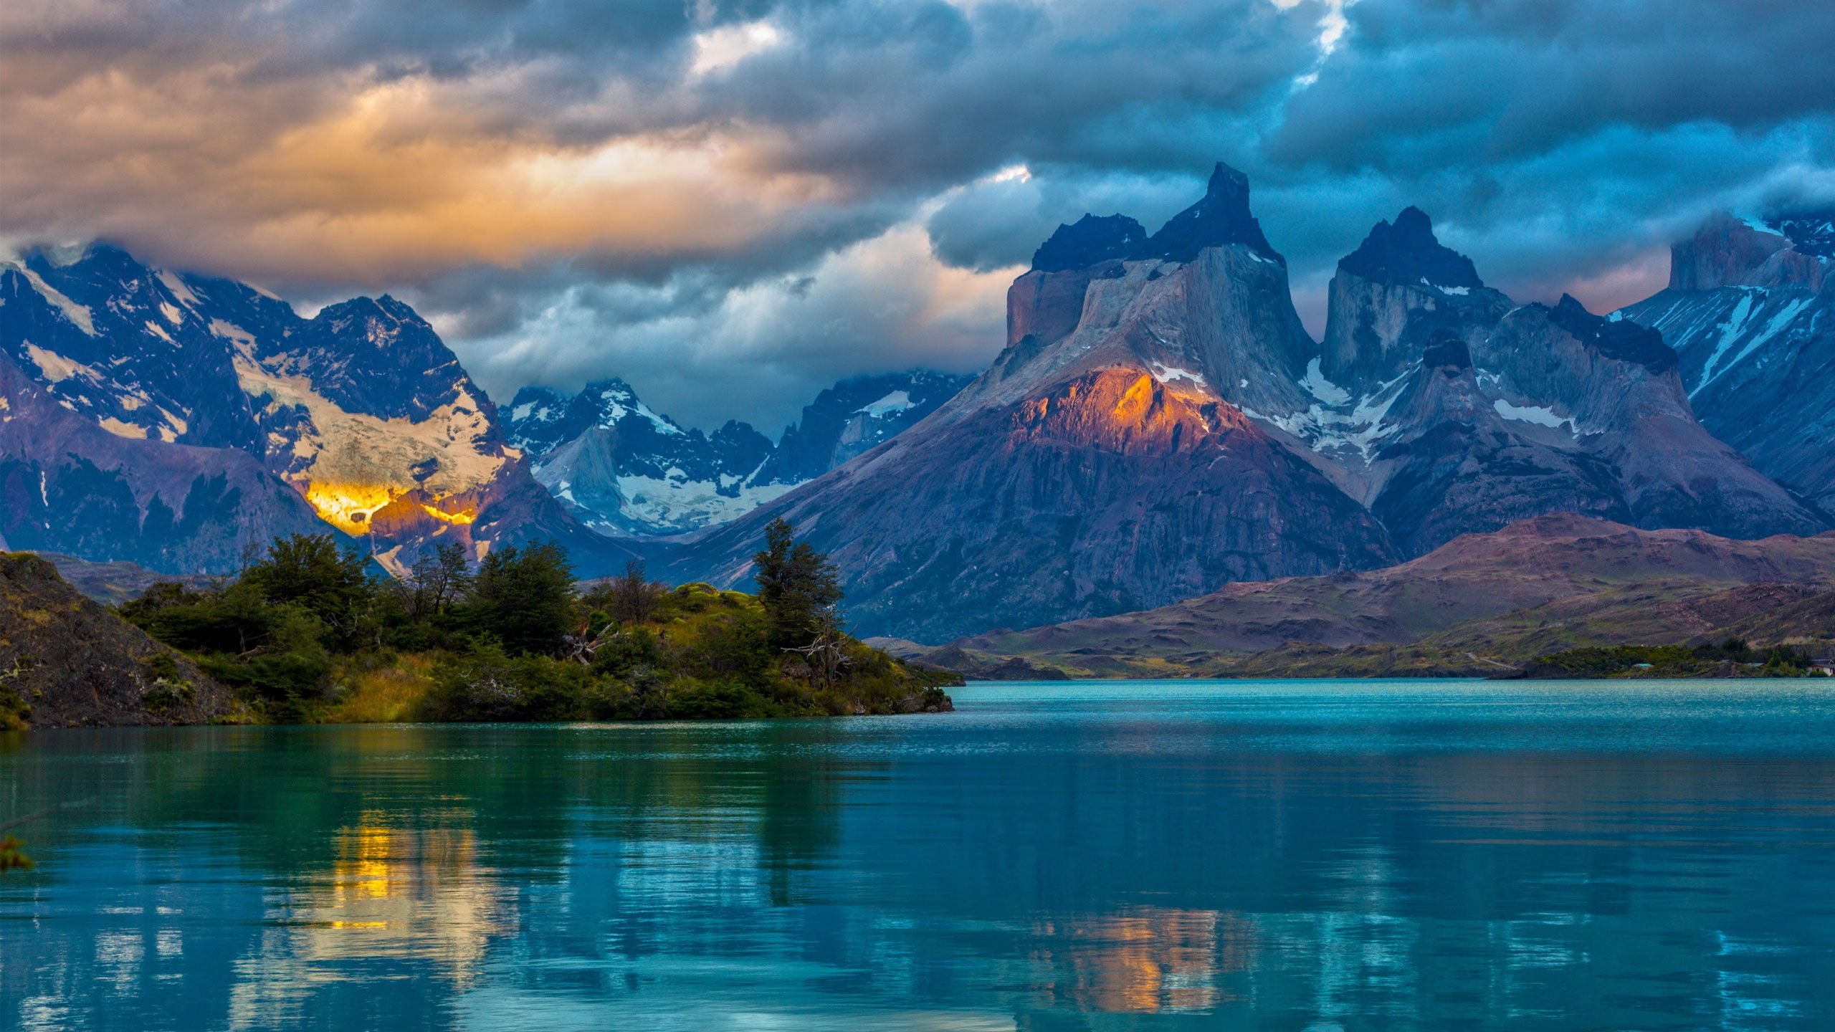
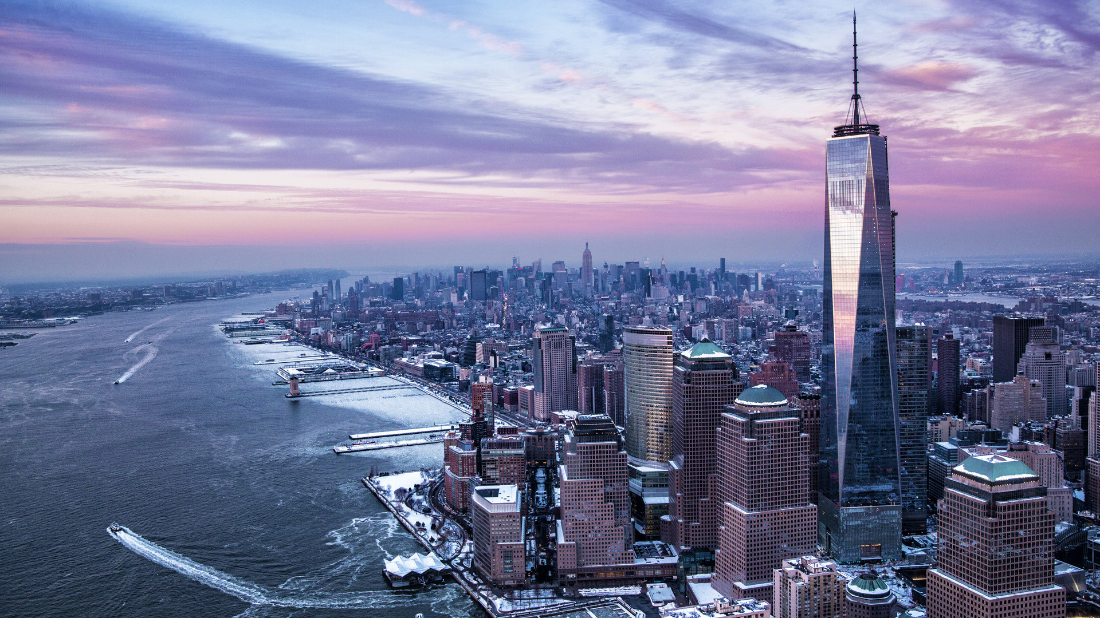
File Explorer
Images
Images
Documents
Images
afternoon.jpg
city.jpg
nsui_beta.jpg
Desktop
Music
Videos
Windows Drives
nestorOS Disk

Slide 56
Images – File Explorer
Images
Documents
Images
afternoon.jpg
city.jpg
nsui.jpg
Desktop
Music
Videos
Windows Drives
nestorOS Disk

Slide 57
File Explorer
Desktop
Desktop
Documents
Images
Desktop
Music
Videos
Windows Drives
nestorOS Disk

Slide 58
Desktop – File Explorer
Desktop
Documents
Images
Desktop
Music
Videos
Windows Drives
nestorOS Disk

Slide 59
File Explorer
Music
Music
Documents
Images
Desktop
Music
Videos
Windows Drives
nestorOS Disk

Slide 60
Music – File Explorer
Music
Documents
Images
Desktop
Music
Videos
Windows Drives
nestorOS Disk

Slide 61
File Explorer
Videos
Videos
Documents
Images
Desktop
Music
Videos
Windows Drives
nestorOS Disk

Slide 62
Videos – File Explorer
Videos
Documents
Images
Desktop
Music
Videos
Windows Drives
nestorOS Disk

Slide 63
Activities
20:44
nsUI
I want to surf the Web
I want to watch a picture
Who are you?
Open File Explorer
Goodbye!
What’s the date?
More questions

Slide 64
Nestoria
I want to surf the Web
Open Settings
I want to watch a picture
I want to paint something
Who are you?
Open File Explorer
I want to watch a video.
Restart the Computer
I want to check the
nestorOS Version
I want to see if there’s more programs
Whats the time?
Turn Off the Computer
Change my wallpaper
Goodbye!
I want to listen to some music
Log me off.

Slide 65
Activities
20:44
nsUI
Im Nestoria, the virtual assistant
of nestorOS and nsUI
Suggestion: “Whats the time?”
Ask other thing

Slide 66
Activities
20:44
nsUI
20:44:20
Suggestion: “Change my wallpaper”
Ask other thing

Slide 67







Configuration
Configuration
Configuration
System
Hard Disks, About nestorOS
Devices
Bluetooth, USB Storages, Other Devices
Appearance
Wallpapers
Hour and Language
Date and Time, Language
Internet
Check if you have Internet Access
Feedback
Report a bug, suggest a idea
nestorOS Update
Check if nestorOS is up to date

Slide 68
Configuration
Configuration
System
Hard Disks, About nestorOS
Devices
Bluetooth, USB Storages, Other Devices
Hour and Language
Date and Time, Language
Appearance
Wallpapers
Internet
Check if you have Internet Access
Feedback
Report a bug, suggest a idea

Slide 69


Configuration
Hard Disks
System / Hard Disks
Hard Disks
C:\ Windows Drives
Disk is neutral
Disk working properly
SSD
283GB free of 641GB
About nestorOS
D:\ NSUI
499GB Free of 500GB
Disk almost empty
Disk is working perfectly
NPSD (NP Solid Drive)
No more disks detected

Slide 70
Configuration
System / Hard Disks
Hard Disks
C:\ Windows Drives
Disk is neutral
Disk working properly
SSD
283GB free of 641GB
About nestorOS
D:\ NSUI
499GB Free of 500GB
Disk almost empty
Disk is working perfectly
NPSD (NP Solid Drive)
No more disks detected

Slide 71
Configuration
About nestorOS
System / About nestorOS
Hard Disks
2013 – 2021 N Industries
nestorOS 21.04 Lite
About nestorOS
Name of this PC: 2104
nsUI Version:
nestorOS Version:
OS Build: 5000
Processor: NP N4 8395 @3.69GHz (6 cores, 12 threads, 8th Gen)
RAM Installed: 8GB (Virtual RAM, DDR4)
Type of System: 64-Bit, processor x64
Release Date: April 16th 2021
Supported Until: October 18th 2022
2013 – 2021 N Industries
1.0
21.04 (Impressive Iberian Lynx)

Slide 72
About nestorOS
System / About nestorOS
Hard Disks
2013 – 2021 N Industries
nestorOS 21.04 Lite
About nestorOS
Name of this PC: 2104
nsUI Version:
nestorOS Version:
OS Build: 5000
Processor: NP N4 8395 @3.69GHz (6 cores, 12 threads, 8th Gen)
RAM Installed: 8GB (Virtual RAM, DDR4)
Type of System: 64-Bit, processor x64
Release Date: April 16th 2021
Supported Until: October 18th 2022
2013 – 2021 N Industries
1.0
21.04 (Impressive Iberian Lynx)

Slide 73
nsUI

Slide 74

nsUI
nsUI v1.0

Slide 75
nsUI

Slide 76
nsUI
nsUI v1.0

Slide 77
nestorOS

Slide 78
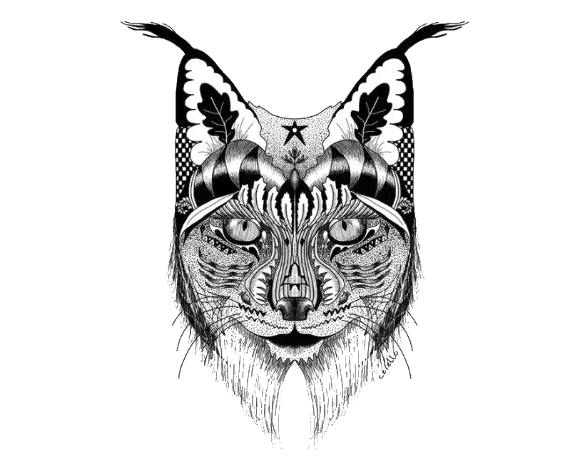
nestorOS
nestorOS 21.04
Impressive Iberian Lynx

Slide 79
nestorOS

Slide 80
nestorOS
nestorOS 21.04
Impressive Iberian Lynx

Slide 81



Configuration
Internal Devices
Devices / Internal Devices
Internal Devices
Bluetooth
This device is not compatible with Bluetooth
USB Devices
Internal Devices
C:/ WINDOWS
SSD
D:/ NESTOROS
NPSD

Slide 82
Configuration
Devices / Internal Devices
Internal Devices
Bluetooth
This device is not compatible with Bluetooth
USB Devices
Internal Devices
C:/ WINDOWS
SSD
D:/ NESTOROS
NPSD

Slide 83
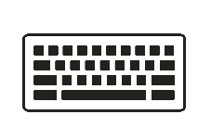


Configuration
USB Devices
Devices / USB Devices
Internal Devices
USB Devices
Generic Keyboard
USB Devices
Generic Mouse
USB Audio Devices
Generic Speakers

Slide 84
Configuration
Devices / USB Devices
Internal Devices
USB Devices
USB Devices
Generic Keyboard
Generic Mouse
USB Audio Devices
Generic Speakers

Slide 85


Configuration
Date and Hour
Hour and Language / Date and Hour
Date and Hour
Date and hour:
Wednesday, April 14, 2021
Language
Time Zone:
UTC-based

Slide 86
Configuration
Hour and Language / Date and Hour
Date and Hour
Date and hour:
Wednesday, April 14, 2021
Language
Time Zone:
UTC-based

Slide 87
Configuration
Language
Hour and Language / Language
Date and Hour
Language:
Your language is english
Language

Slide 88
Configuration
Hour and Language / Language
Date and Hour
Language:
Your language is english
Language

Slide 89

Configuration
Wallpaper
Appearance / Wallpaper
Wallpaper
You can change your wallpaper here
Change Wallpaper
Change Lockscreen Wallpaper
Change Sign On Wallpaper

Slide 90
Configuration
Appearance / Wallpaper
Wallpaper
You can change your wallpaper here
Change Wallpaper
Change Lockscreen Wallpaper
Change Sign On Wallpaper

Slide 91
Configuration
Internet
Internet
Internet
By clicking detect, you can check if you
have internet connection or not.
Detect

Slide 92
Internet
Internet
Internet
By clicking detect, you can check if you
have internet connection or not.
Detect

Slide 93
Configuration
nestorOS Update
nestorOS Update

Slide 94
nestorOS Update
nestorOS Update

Slide 95


Activities
20:44
nsUI
Notepad
Calculator
Musify 7X
Filmify 7X
Imagify 7X
Paint

Slide 96
Notepad
Font
Page Color
Times New Roman
A
Inter
A
Arial
A
Text Color
Bodoni MT
A
Bradley Hand
A
Forte
A
Felix Titling
A
Symbol
Δ
Allignment
L
C
R
Effects
B
I
U
R
Size

Slide 97
Musify 7X
Load from YouTube
Load from iTunes
Load from your PC
Load from Spotify

Slide 98
Musify 7X
Load from YouTube
Load from iTunes
Load from your PC
Load from Spotify

Slide 99
Musify 7X
+
No Media Selected
Load from YouTube
Load from iTunes
Load from your PC
Load from Spotify

Slide 100
Musify 7X
Load from YouTube
Load from iTunes
Load from your PC
Load from Spotify

Slide 101
Open app…
CyWeb v1
Calculator
Filmify 7X
Imagify 7X
File Explorer

Slide 102
Musify 7X
Filmify 7X
No Media Selected
+

Slide 103
Musify 7X
Imagify 7X
No Media Selected
Import (19:9)
Import (16:10)
Import (16:9)
Import (19,5:9)
Import (1:1)
Import (4:3)
Import (21:9)
Import (18:9)
Import (20:9)

Slide 104
Filmify 7X
Load from YouTube
Load from Vimeo
Full Screen
Load from your PC

Slide 105
Filmify 7X
Load from YouTube
Load from Vimeo
Full Screen
Load from your PC

Slide 106
Filmify 7X
Exit Fullscreen

Slide 107
Filmify 7X
Exit Fullscreen

Slide 108
Filmify 7X
+
Load from YouTube
Load from Vimeo
Full Screen
Load from your PC
+

Slide 109
Open app…
CyWeb v1
Calculator
Musify 7X
Imagify 7X
File Explorer

Slide 110
Filmify 7X
Imagify 7X
+
Import (19:9)
Import (16:10)
Import (16:9)
Import (19,5:9)
Import (1:1)
Import (4:3)
Import (21:9)
Import (18:9)
Import (20:9)

Slide 111
Imagify 7X
Load from Google
Load from Deviantart
Load from your PC
Load from Windows

Slide 112
Imagify 7X
Load from Google
Load from Deviantart
Load from your PC
Load from Windows

Slide 113
Imagify 7X
Load from Google
Load from Deviantart
Load from your PC
Load from Windows
afternoon.jpg
city.jpg
nsui.jpg
Full View

Slide 114
Imagify 7X
Load from Google
Load from Deviantart
Load from your PC
Load from Windows
afternoon.jpg
city.jpg
nsui.jpg
Full View

Slide 115
Imagify 7X
Load from Google
Load from Deviantart
Load from your PC
Load from Windows
afternoon.jpg
city.jpg
nsui.jpg
Full View

Slide 116
Imagify 7X
+
Load from Google
Load from Deviantart
Load from your PC
Load from Windows
Import (16:9)
Import (4:3)
Import (20:9)
Show more…

Slide 117
Imagify 7X
+
Load from Google
Load from Deviantart
Load from your PC
Load from Windows
Import (16:9)
Import (4:3)
Import (20:9)
Show less…
Import (16:10)
Import (1:1)
Import (18:9)
Import (19:9)
Import (19,5:9)
Import (21:9)

Slide 118
Open app…
CyWeb v1
Calculator
Musify 7X
Filmify 7X
File Explorer

Slide 119


Imagify 7 (Full View)
afternoon.jpg

Slide 120
Imagify 7 (Full View)
city.jpg

Slide 121
Imagify 7 (Full View)
nsui_beta.jpg

Slide 122
Paint

Slide 123
Calculator
Calculator
+
1
2
3
+
4
5
6
-
*
7
8
9
/
0
C
=

Slide 124
Calculator
+
1
2
3
+
-
4
5
6
*
7
8
9
/
0
C
=

Slide 125
Open app…
CyWeb v1
Musify 7X
Filmify 7X
Imagify 7X
File Explorer

Slide 126
Calculator
Musify 7X
No Media Selected
1
2
3
+
-
4
5
6
*
7
8
9
/
0
C
=

Slide 127
Calculator
Filmify 7X
+
1
2
3
+
-
4
5
6
*
7
8
9
/
0
C
=

Slide 128
Calculator
Imagify 7X
Import (19:9)
Import (16:10)
Import (16:9)
Import (19,5:9)
Import (1:1)
Import (4:3)
Import (21:9)
Import (18:9)
Import (20:9)
1
2
3
+
-
4
5
6
*
7
8
9
/
0
C
=

Slide 129



Activities
20:44
nestorOS
Notes
20:44
Wednesday, April 14, 2021
OS: nestorOS 21.04 Lite
Change Background
Settings
About nestorOS

Slide 130
Activities
20:44
nsUI
Shutdown
What are you going to do?
Shutdown
Restart
Log Off
Cancel

